Slide 1

Joint Strategic Needs Assessment (JSNA) place-based approach
Notes:
Intro my role

Slide 2

Overview
What is a JSNA
Why and what is a needs assessment?
Initial work to date
Next Steps
Notes:
Intro my role

Slide 3
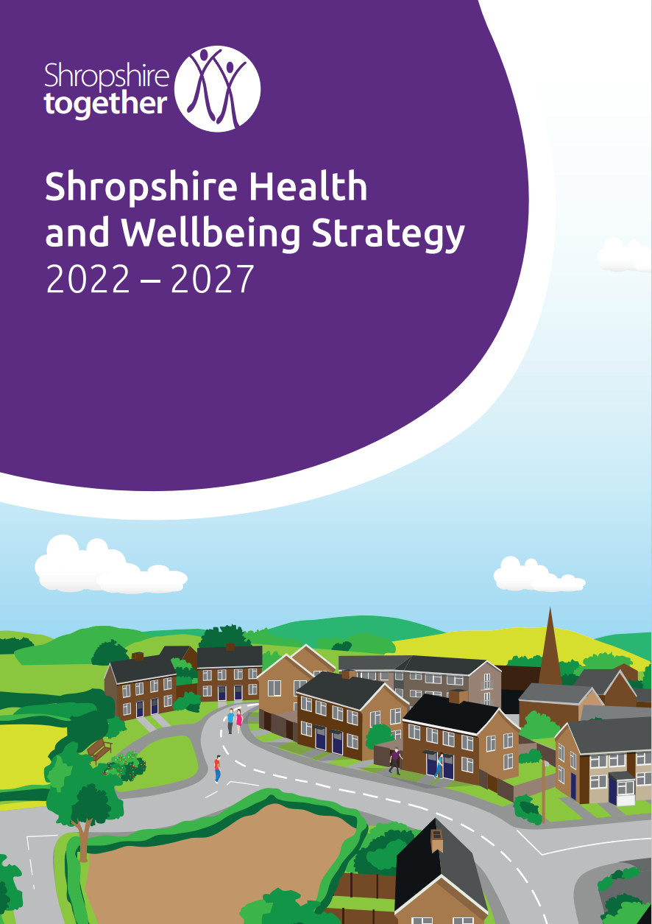
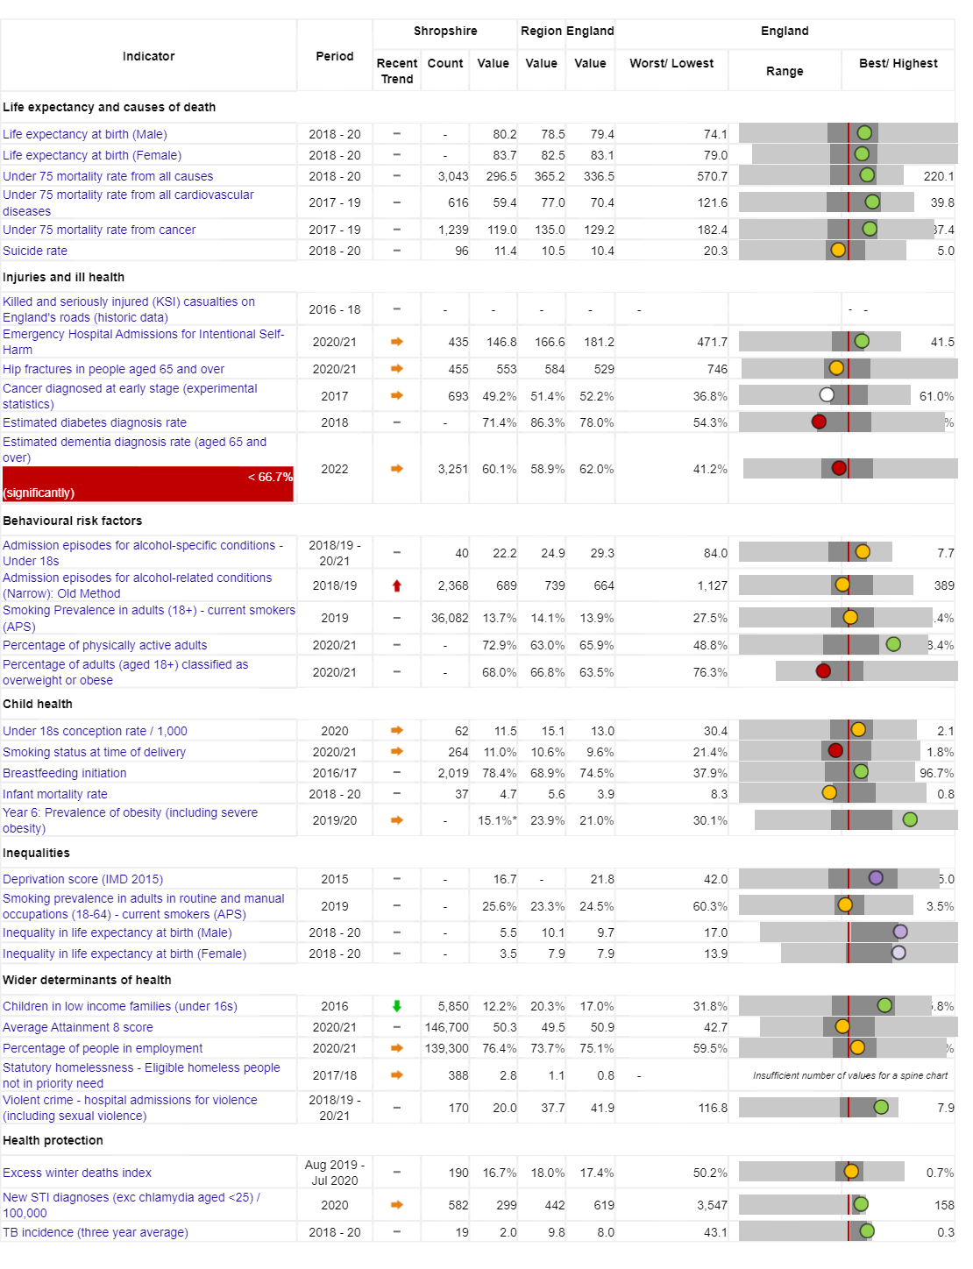
Shropshire: Health and
Wellbeing Challenges
Vision: For Shropshire
people to be the healthiest
and most fulfilled in England
Reducing inequalities
Improving Population Health
Working with and building strong and
vibrant communities
Joined up working

Slide 4
Today people in Oswestry are living longer, but not necessarily healthier lives…
Measure | England | Shropshire | Range (Ward) | Range (Ward)
IMD Score | 21.7 | 17.2 | 3.7 (Copthorne) | 37.6 (Harlescott)
Life expectancy at birth, (Male) | 79.7 | 80.5 | 75.3 (Sundorne) | 85.8 (Copthorne)
Life expectancy at birth, (Female) | 83.2 | 83.6 | 79.5 (Tern) | 89.6 (Clun)
Deaths all causes, all ages, SMR | 100 | 96.7 | 65.4 (Copthorne) | 145 (Worfield)
Deaths all causes, under 75, SMR | 100 | 89.7 | 55.2 (Clun) | 149 (Sundorne)
Preventable deaths, under 75, SMR | 100 | 85.7 | 48.2 (Corvedale) | 160.6 (Sundorne)
Indicator | Shropshire | England
Healthy Life Expectancy (HLE) Males | 62.8 | 63.1
Inequality in HLE Males | 5.5 | 9.7
HLE Females | 67.1 | 63.9
Inequality in HLE Females | 3.5 | 7.9
Area | Oswestry | Shrewsbury
Healthy Life Expectancy | 66.1 years | 72.7 years
Life Expectancy | 82.1 years | 84.4 years

Slide 5
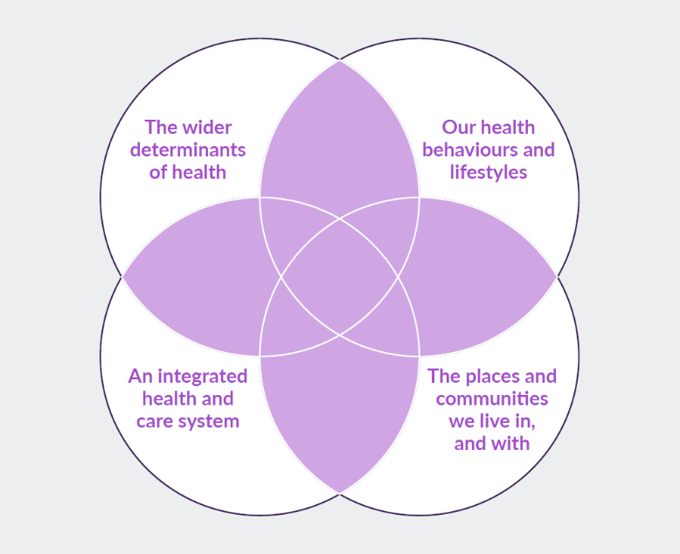
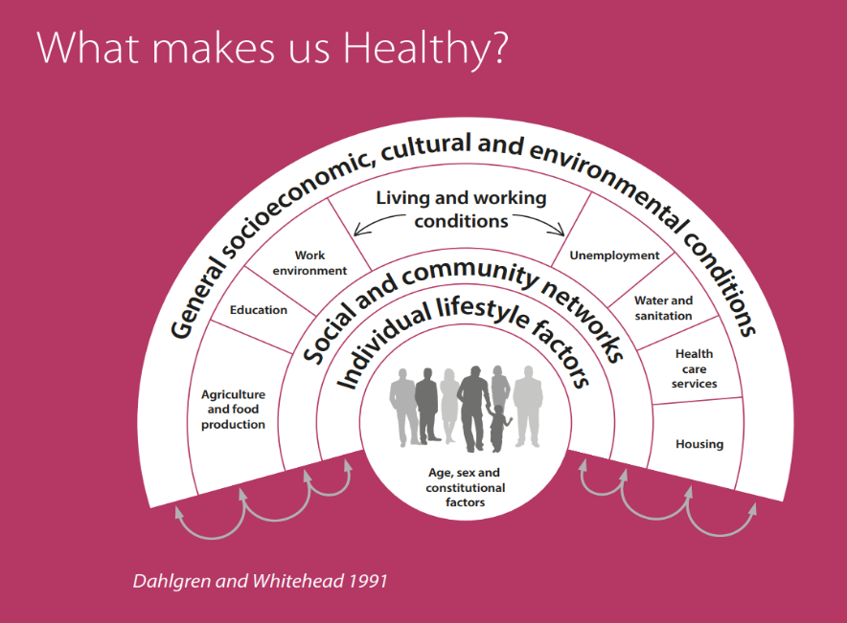
What makes us healthy?
Understanding and Addressing Inequalities – taking a preventative approach
Health Protection
Understanding our Population Health/Population Health Management (Insight/JSNA)

Slide 6
Joint Strategic Needs Assessment
Local Authorities and CCGs (now ICS) have a legal Statutory Duty to undertake a Joint Strategic Needs Assessment (JSNA), through the health and wellbeing board.
The JSNA seeks to identify current and future health and wellbeing needs in the local population and identify strategic priorities to inform commissioning of services based on those needs.
These priorities in turn inform the Health and Wellbeing Strategy and Integrated Care Strategy, key documents as a basis for commissioning health and social care services in the local area.
The JSNA aims to achieve the following through an evidence base and consultation:
  Identify the health and wellbeing needs of the population;
  Map the services/assets in the area;
  Define achievable improvements in health and wellbeing outcomes for the local community.
  Target services and resources where there is most need
  Support commissioners, stakeholders and communities to deliver better health and wellbeing outcomes for the local community by making recommendations for how services can be improved / redesigned to make sure they are being delivered to the people who need them most.

Slide 7
Previously Shropshire JSNA priorities were thematic
Needs assessments were/are produced for those priorities for which a demonstrable and imminent commissioning decision needed to be made.
Strategic priorities in 2019 and 2020 are highlighted below:
Starting well
Smoking in pregnancy and local maternity services
Child and adolescent mental health
Educational outcomes for vulnerable children and young people
School Readiness
LD and Autism
Oral Health
Living well
Alcohol
Healthy Weight including healthy eating, nutrition and Physical activity
Diabetes
Smoking Cessation
Cardio-vascular Disease
Cancer
Road Traffic Collisions
Mental Health and Suicide Prevention
Ageing well
Dementia
Falls and MSK ? Link to Physical Activity
End of Life
Isolation
Carers
Frailty
Vulnerable communities
Youth Unemployment
Low Workplace Earnings
Food Poverty
Homelessness
County Lines
Domestic Abuse
Adverse Childhood Experiences
Wider Determinants

Slide 8
Shropshire's JSNA – Place based
Priorities place-based from 2019 onwards (delayed due to COVID), focusing on local places/ localities/communities. Why?
Common/shared and best available evidence base
Collectively understand the health and wellbeing needs of communities
Understand the unique needs of people in a given location by working together to gain local knowledge and insight.
Asset-based approach that seeks to highlight the strengths, capacity and
knowledge of all those involved.

Slide 9

“The JSNA should be the source of the spring from which everything flows”
The JSNA should be the single source of evidence for place-based activity

Slide 10
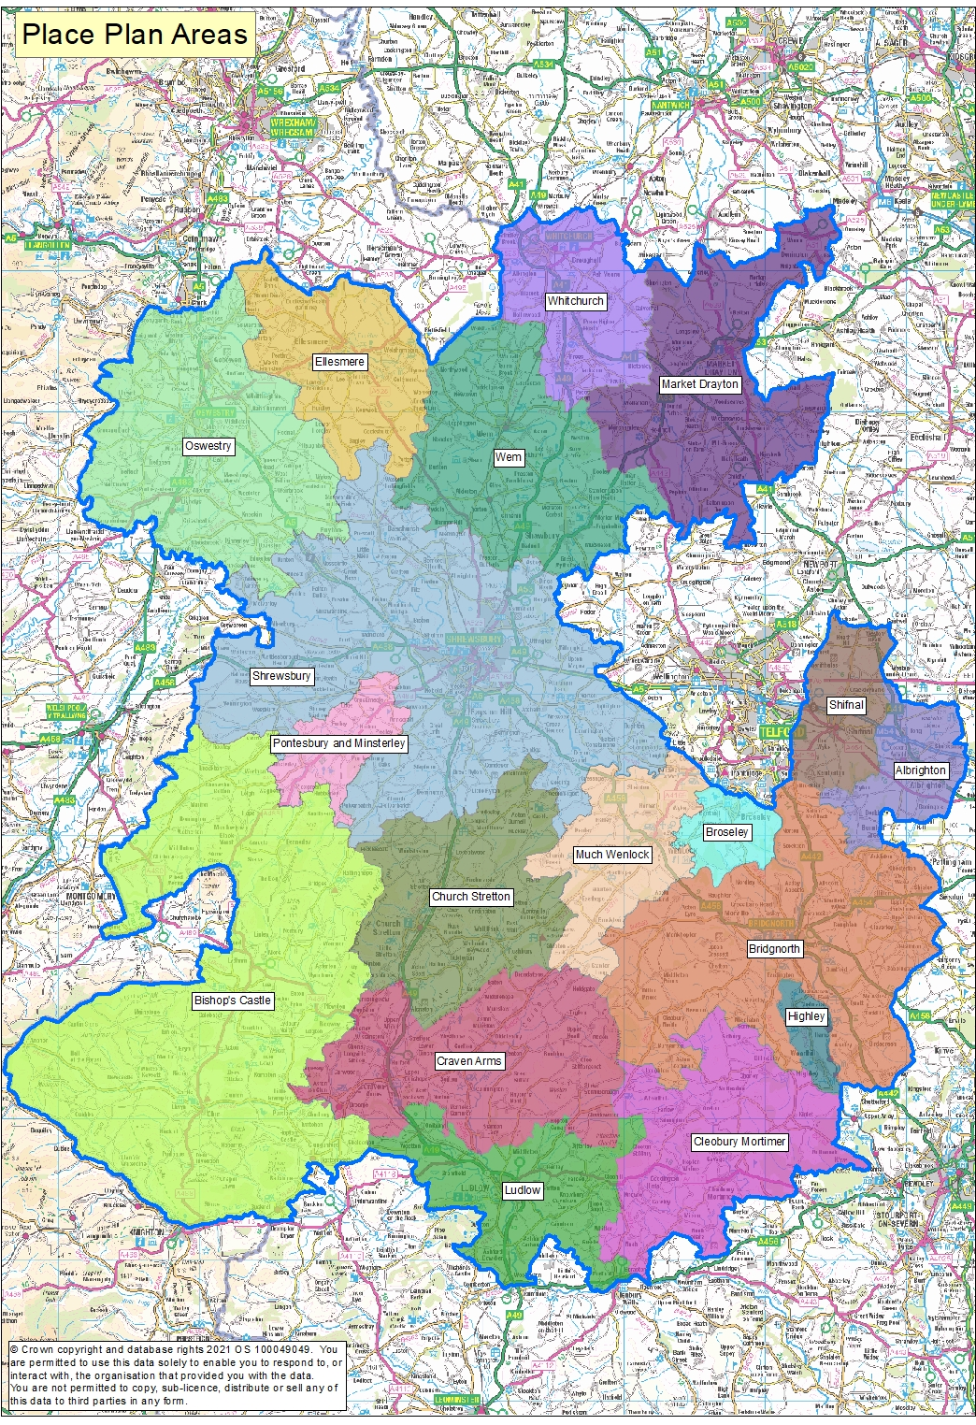
Phase 1: Place Based
As well as the overall JSNA for Shropshire, JSNAs are being produced around smaller localities – namely Place Plan Areas
There are 18 place plan areas in Shropshire, usually (not always) focused on a market town and its surrounding rural communities.
Place Plan Areas are based along geographical/communities boundaries rather than political ones
There are enough Place Plan Areas to identify some differences in the areas to help with local planning, but not too many areas where it becomes difficult to identify meaningful differences

Slide 11
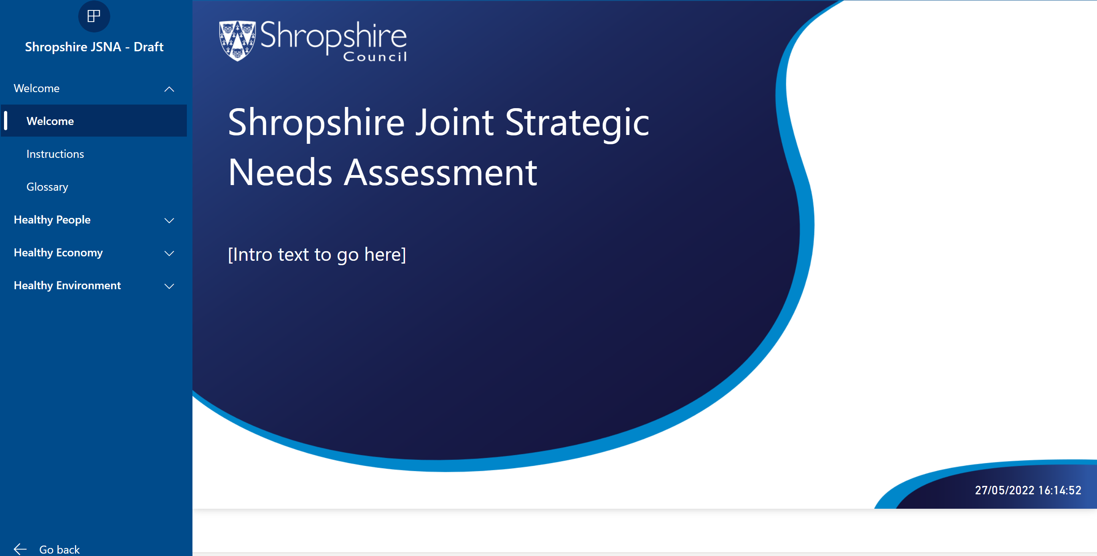
Phase 2 - JSNA Place-based profiler tool

Slide 12
Phase 3 – Community Engagement
Stakeholder and Resident engagement via:
  Questionnaires to residents
  Interviews
  Focus Groups
  Attending key meetings/groups

Slide 13
Phase 3 - Place-based Needs Assessments
Production of a set of detailed needs assessments for each JSNA area
  providing strategic planners and commissioners with an in-depth understanding of the specific local needs of each community
  approach is being piloted in Highley
The next step is to agree the most effective method for delivering the detailed needs assessment phase of work
  Including prioritisation, content, resource and ownership
Complete Pilot and agree documentation and approach
  Needs Assessments
  Issues and Recommendations
  Working draft action plan

Slide 14
Phase 3 – Roll Out
This will be a two year work programme with the main work restarting in summer 2022 :
  Highley
  Oswestry (and surrounding)
  Whitchurch(and surrounding)
  Bishops Castle (and surrounding)
  Shrewsbury (and surrounding)
  Ludlow (and surrounding)
  Market Drayton (and surrounding)
  Bridgenorth (and surrounding)

Slide 15

Oswestry Place Plan
Examples of Key Health and Wellbeing Data
Notes:
Intro my role

Slide 16
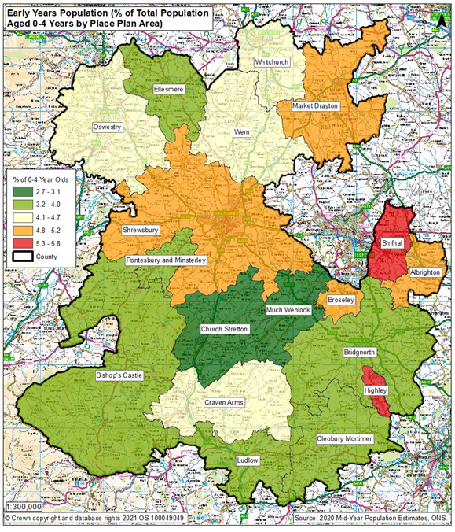
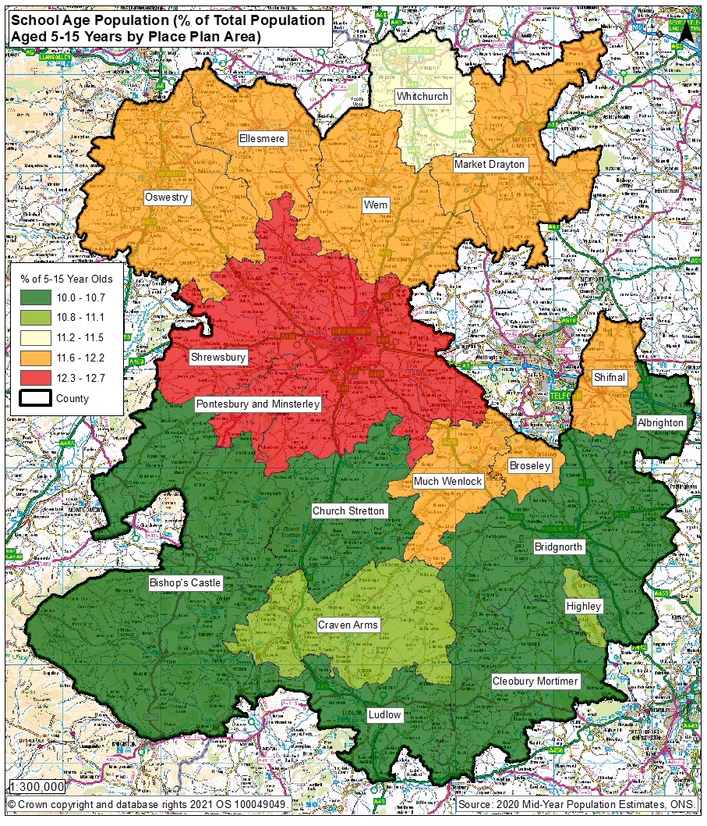

Slide 17
Ranking of Wards in Oswestry Place Plan Area in metrics
 | Ranking of Ward in Indicator out of 62 wards in Shropshire – lowest number is worse
Indicator | Oswestry East | Oswestry West | St Martin's | Oswestry South | St Oswald | Gobowen, Selattyn and Weston Rhyn | Llanymynech | Ruyton and Baschurch
Unemployment | 16 | 9 | 29 | 5 | 41 | 25 | 54 | 47
Child Poverty, English Indices of Deprivation, 2019 | 10 | 8 | 12 | 41 | 32 | 20 | 38 | 54
Income deprivation, English Indices of Deprivation, 2019 | 8 | 9 | 12 | 18 | 32 | 18 | 50 | 59
IMD Score, 2019 | 19 | 15 | 24 | 26 | 37 | 28 | 24 | 60
Long term unemployment | 9 | 5 | 30 | 2 | 48 | 40 | 27 | 53
General fertility rate: live births per 1,000 women aged 15-44 years | 23 | 34 | 19 | 57 | 20 | 44 | 40 | 38
Low birth weight of live babies | 8 | 31 | 11 | 22 | 9 | 45 | 55 | 34
A&E attendances in under 5 years old, three year average | 45 | 54 | 62 | 57 | 61 | 60 | 46 | 36
Emergency admissions in under 5s | 58 | 57 | 63 | 59 | 60 | 61 | 45 | 36
Emergency hospital admissions for injuries in under 15 years old | 57 | 61 | 62 | 60 | 58 | 63 | 38 | 35
RANK OF AVERAGE RANK (lower number is worse) | 14 | 24 | 30 | 33 | 50 | 52 | 53 | 59

Slide 18
Smoking in Pregnancy
Background
Smoking in pregnancy has long been recognised as having significantly negative health impacts for the growth and development of the baby and the health of the mother including complications in labour, miscarriage, still birth, premature birth and low birth weight. Reduced smoking in pregnancy will have health benefits for both mother and child and reduced costs to the NHS.
Methodology
Smoking at time of delivery is the number of mothers known to be smokers at time of delivery as a percentage of all maternities (live or still birth). The Place Plan area figures are based on those mothers who lived in that place plan area who delivered a child at Shrewsbury and Telford Hospitals Trust (SATH). Because there are very few deliveries in some of the place plan areas in one year, these figures are the combination of the last 5 years – 2016/17 to 2020/21. The Oswestry % v Shropshire is a statistical comparison of the two areas to take into account the different number of children in those areas, based on a 95% confidence interval using the Wilson scoring method.
Caveats
The data shown here concerns mothers who delivered a child at SATH only, not mothers from the area who delivered in other hospital providers.
Results
Oswestry had 940 deliveries in this 5 year period, which is the 2nd highest of all place plan areas behind Shrewsbury. The 5 year percentage for smoking at delivery for Oswestry (16.5%) is statistically higher than Shropshire’s (12.8%) – 3 place plan areas had a higher percentage of mothers smoking at delivery. For this same cohort of mothers, the percentage known to be smokers at time of booking who lived in Oswestry was 17.6%, statistically higher than the Shropshire figure of 14%.
5 year Smoking at Delivery and at Booking data for Shropshire and Oswestry Place Plan Area, 2016/17 to 2020/21
Indicator | Oswestry Place Plan Area | Shropshire Overall | Highley % v Shropshire
Number of deliveries | 940 | 10,289
Percentage of mothers who were known to be smoking at time of delivery | 16.5% | 12.8% | Higher
Percentage of mothers who were known to be smoking at time of booking | 17.6% | 14.0% | Higher
Source: SATH Maternity Dataset for 2016/17, 2017/18, 2018/19, 2019/20 and 2020/21

Slide 19
Quality & Outcomes Framework (QOF) Indicators 2020/21
Key to colour codes on table
Area is statistically higher for this indicator than Shropshire
Area is statistically similar for this indicator to Shropshire
Area is statistically lower for this indicator than Shropshire
Indicator | Oswestry Place Plan Area Eligible population | Oswestry Place Plan Area Prevalence for indicator | NHS Shropshire, Telford and Wrekin CCG
AF Prevalence | 39,650 | 2.7% | 2.5%
CHD Prevalence | 39,650 | 3.4% | 3.5%
Heart failure Prevalence | 39,650 | 1.0% | 0.9%
Heart failure due to LVSD Prevalence | 39,650 | 0.4% | -
Hypertension Prevalence | 39,650 | 16.9% | 15.6%
Peripheral arterial disease Prevalence | 39,650 | 0.8% | 0.8%
Stroke and transient ischaemic attack Prevalence | 39,650 | 2.5% | 2.4%
COPD Prevalence | 39,650 | 2.1% | 2%
Asthma Prevalence (6+) | 37,496 | 7.2% | 7.1%
Obesity Prevalence (18+) | 32,387 | 6.6% | 7.3%

Slide 20
QOF Indicators 2020/21
Key to colour codes on table
Area is statistically higher for this indicator than Shropshire
Area is statistically similar for this indicator to Shropshire
Area is statistically lower for this indicator than Shropshire
Indicator | Oswestry Place Plan Area Eligible population | Oswestry Place Plan Area Prevalence for indicator | NHS Shropshire, Telford and Wrekin CCG
High dependency and other long term conditions group, cancer Prevalence | 39.650 | 4.0% | 4%
High dependency and other long term conditions group, palliative care Prevalence | 39.650 | 0.5% | 0.4%
Mental health and neurology group, dementia Prevalence | 39.650 | 1.0% | 0.9%
Mental health and neurology group, learning disabilities Prevalence | 39.650 | 0.6% | 0.5%
Mental health and neurology group, mental health Prevalence | 39.650 | 0.8% | 0.8%
Musculoskeletal group, rheumatoid arthritis Prevalence (16+) | 33,319 | 1.0% | 0.9%
High dependency and other long term conditions group, diabetes mellitus Prevalence (17+) | 32,846 | 7.1% | 7.3%
High dependency and other long term conditions group, chronic kidney disease Prevalence (18+) | 32,387 | 6.7% | 5.7%
Mental health and neurology group, depression Prevalence (18+) | 32,387 | 16.0% | 14.5%
Mental health and neurology group, epilepsy Prevalence (18+) | 32,387 | 1.0% | 0.9%
Non-diabetic hyperglycaemia group, non-diabetic hyperglycaemia Prevalence (18+) | 32,387 | 5.6% | 4.6%
Musculoskeletal group, osteoporosis Prevalence (50+) | 18,325 | 1.9% | 0.9%

Slide 21
Deprivation 2020/21
 | CYP aged 5 to 18 living in 20% most deprived quintile relative to Shropshire | CYP aged 5 to 18 living in 20% most deprived quintile relative to England | Deprivation (IMD)
Central South | 1742 | 1112 | 17.1
Central North | 1473 | 753 | 15.5
North East | 2375 | 326 | 20.2
North West | 1698 | 339 | 18.3
South East | 972 | 0 | 15.1
South West | 1097 | 203 | 19.5
Shropshire | 9357 | 2733 | 17.1

Slide 22
Phase 3 – Roll Out Oswestry
Initial data collection phase 2 profiling
Initial community engagement including raising awareness today
Future stakeholder meetings to review data so far:
  Additions – are there gaps?
  Identify key themes
  Develop recommendations for action
Targeted work arising from Needs Assessment
Learning about place based approach & lessons learnt

